Slide 2
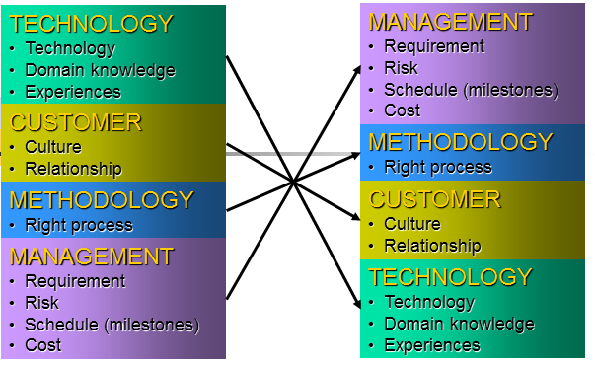
Notes:
管理对于软件开发至关重要

Slide 3
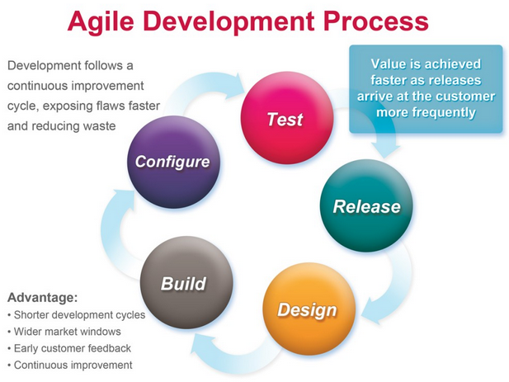
Notes:
Agile迭代开发有效保证软件质量，是软件开发的热点

Slide 4
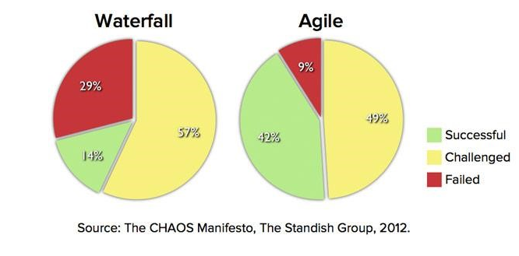
Notes:
Agile开发的优势

Slide 5
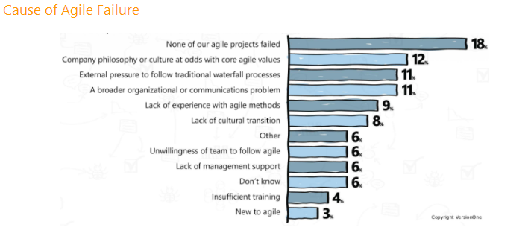
Notes:
Agile开发的失败原因主要是管理问题、沟通的问题、缺少agile开发的经验

Slide 6
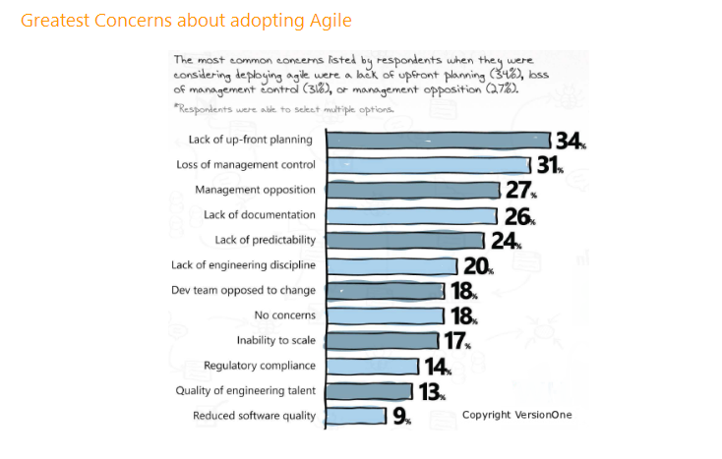
Notes:
软件开发团队不采用agile开发是因为计划、管理、文档等原因

Slide 7
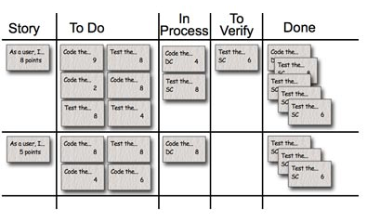
应用领域：基与web的软件开发管理
Notes:
我们设计一个工具来帮助软件开发团队来采用agile方式进行开发
Story: The story description (“As a user we want to…”) shown on that row.
To Do: Place for all cards that are not in the “Done” or “In Process” columns for the current sprint.
Work In Process: Any card being worked on goes here. The programmer who chooses to work on it moves it over when she's ready to start the task. Often, this happens during the daily scrum when someone says, “I'm going to work on the boojum today.”
To Verify: A lot of tasks have corresponding test task cards. So, if there's a “Code the boojum class” card, there is likely one or more task cards related to testing: “Test the boojum”, “Write FitNesse tests for the boojum,” “Write FitNesse fixture for the boojum,” etc. Some task cards don't get corresponding test cards (“Fix Bug No. 321 in Bugzilla”) so those are placed in the “To Verify” column.
Done: Cards pile up over here when they're done. They're removed at the end of the sprint. Sometimes we remove some or all during a sprint if there are a lot of cards.

Slide 8
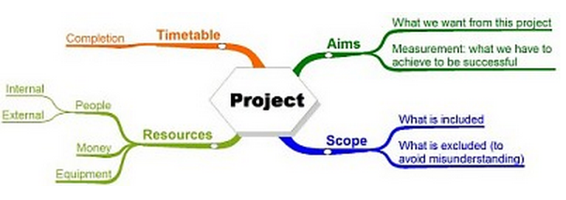
Notes:
基本功能
product planning，查看所有的backlog，软件需求，开发计划，sprint进度，sprint记录，碰到的问题的汇总
sprint planning，方便的创建sprint schedule，标注sprint中需要注意的issue。
sprint tracking，基于故事板的开发进度跟踪，实时交流，issue发现
sprint review，回顾此次迭代开发进度情况，使用图表直观展现，burndown chart，velocity chart…

Slide 9
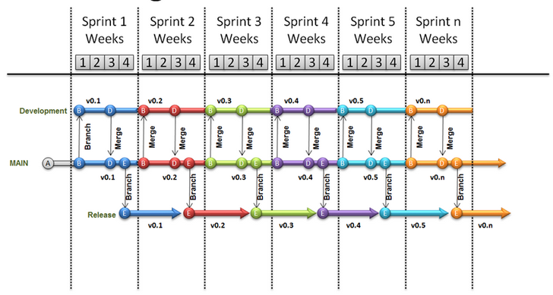
Notes:
Sprint overview

Slide 10
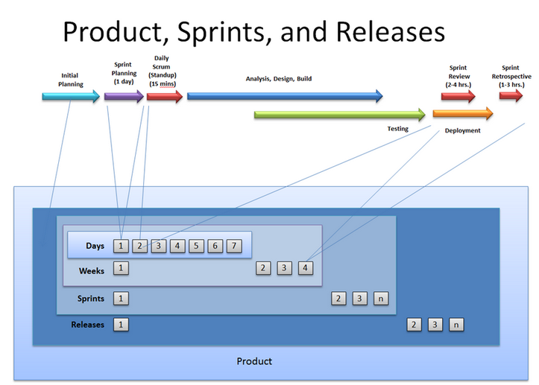
Notes:
Sprint planning

Slide 11
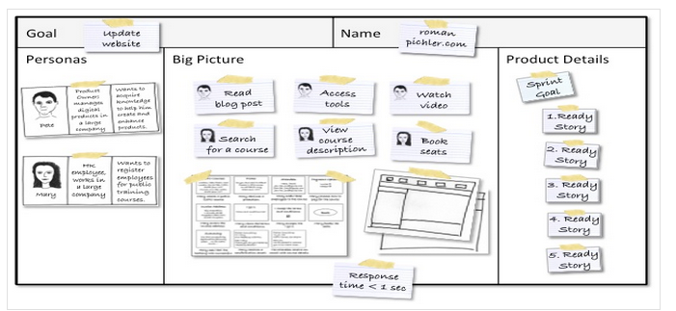
Notes:
Sprint tracking

Slide 12
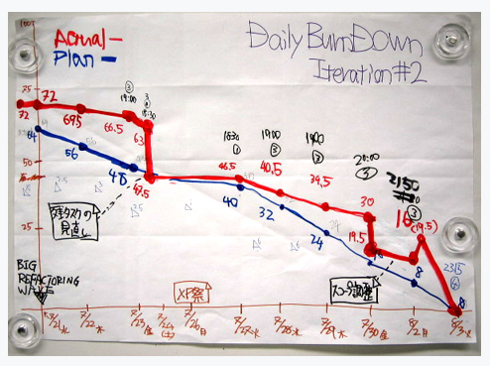
Notes:
Sprint review

Slide 13
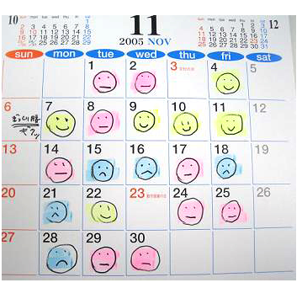
Notes:
日程管理

Slide 14
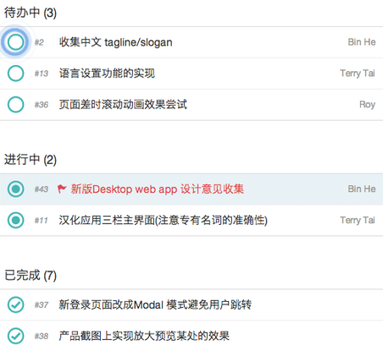
Notes:
扩展功能
个人工作管理，个人任务历史记录
实时讨论体验，在线文档协同编辑，即时消息通知（弹窗，email，社交软件？），项目全局通知
直观团队成员管理，资料共享，日程导览
手机客户端消息同步

Slide 16
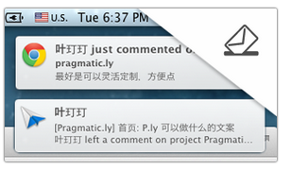
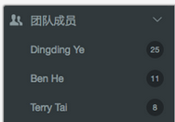
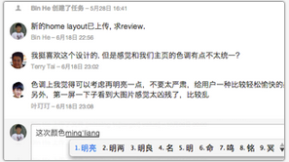


Slide 17
Notes:
主要特征：agile，easy，professional
用户分类：付费？，免费，游客
预期目标：提高软件管理的效率

Slide 18
Notes:
后面讲plan

